Slide 1
Mercy Health Pharmacy Overview
February 2019

Slide 2
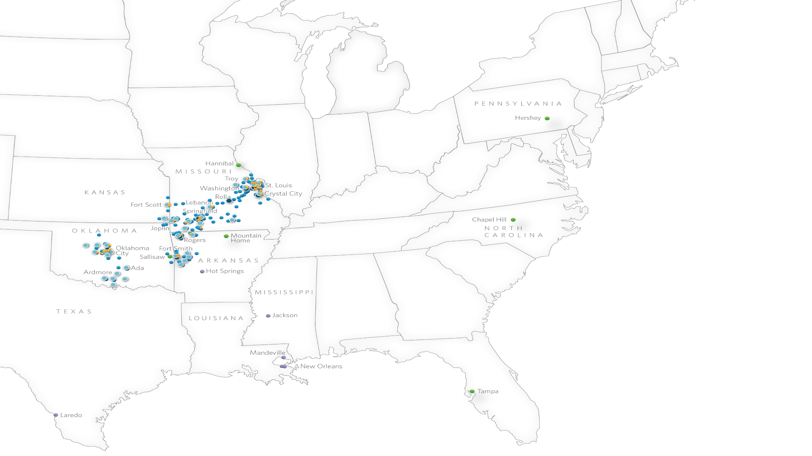
An Overview of Mercy
Services & Locations
June 2017

Slide 3
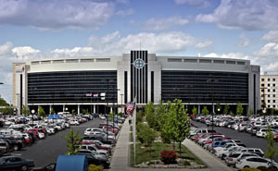
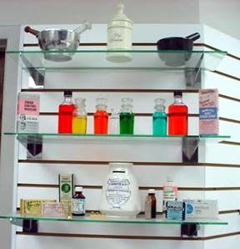
Mercy Pharmacy Overview
Pharmacies
FTE’s
Labor Expense
Annual Drug Spend
Annual Retail Scripts
34 Retail/Community & Specialty Pharmacies
44 Hospital Pharmacy/Drug Rooms
9 Outpatient Infusion Pharmacies
2 Home Infusion locations
650 FTE’s
$74 million
$595 million
1.4 million

Slide 4
Pharmacy’s Scope within Mercy
Home Infusion
Hospital
Discharge
Ambulatory/Retail
Support timely hospital discharge
Care Paths
Med Rec
Medication Stewardship
Concierge D/C Program for compliance
Med Rec
Clinical/MTM programs
Chronic Disease Management
Capture Retail Volume/Refills
Hospital Based OP Settings
Infusion
Specialty Pharmacy
Manage Drug Benefit
Manage Drug Benefit
Specialty Pharmacy
Clinical Programs
Provide complex medications in the home setting
Pharmacy Care Coordination & Enterprise EHR

Slide 5
Graying of lines
Retail vs. Hospital pharmacy
Discharge Concierge Prescription services
MTM needed across the continuum
Hospital vs. Clinic delivery of care
Oncology Infusion moving back to be a hospital function
GPO pricing vs. PBM pricing
Strong need to align inpatient and outpatient formularies in ACO world to deal with bundled payments

